Slide 1
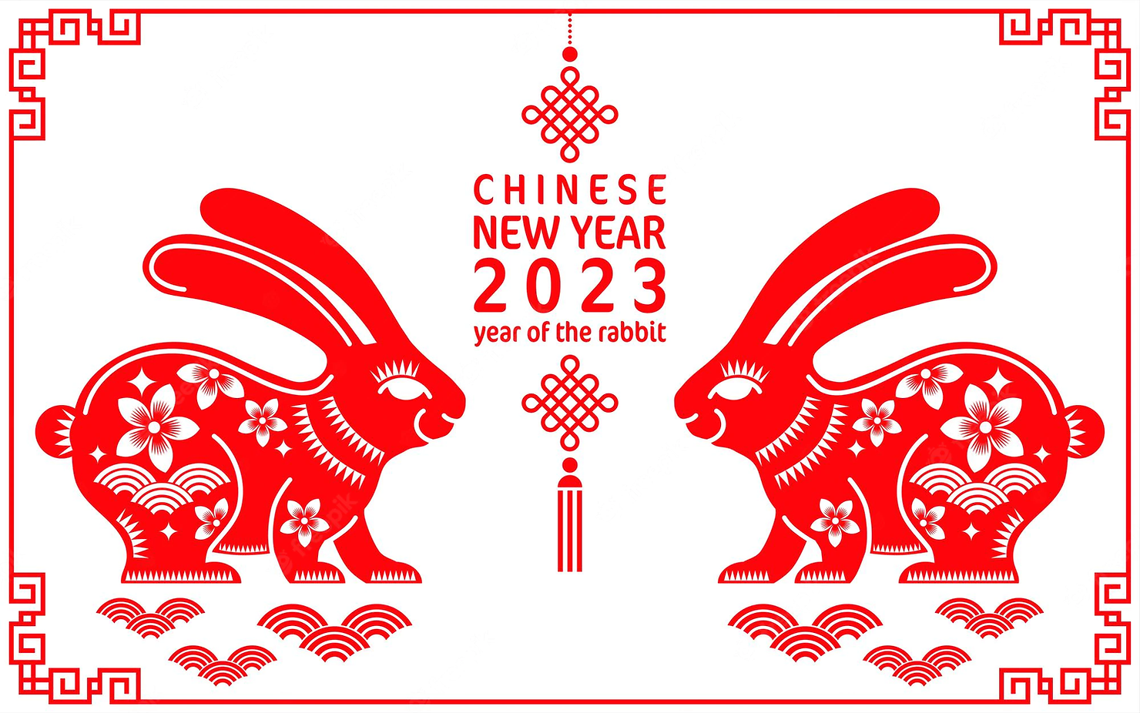

Slide 2
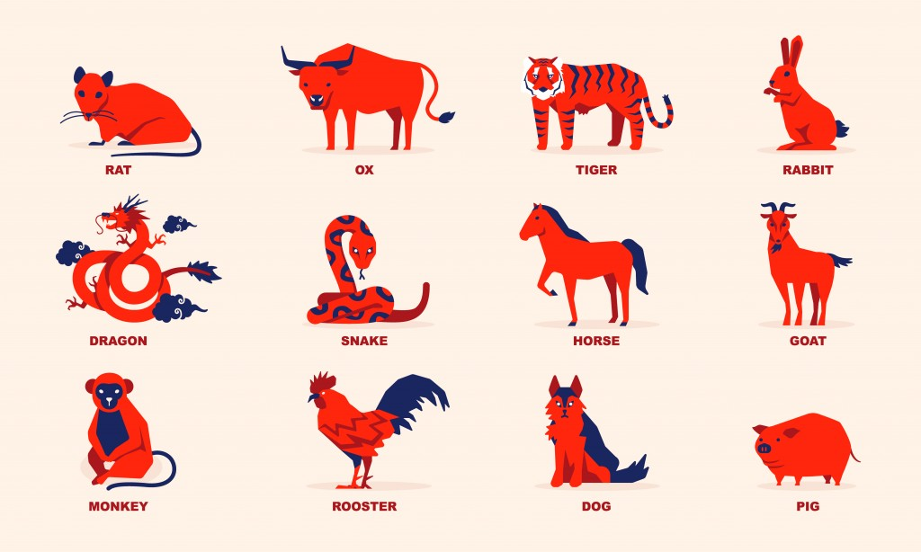
The Chinese Zodiac

Slide 3
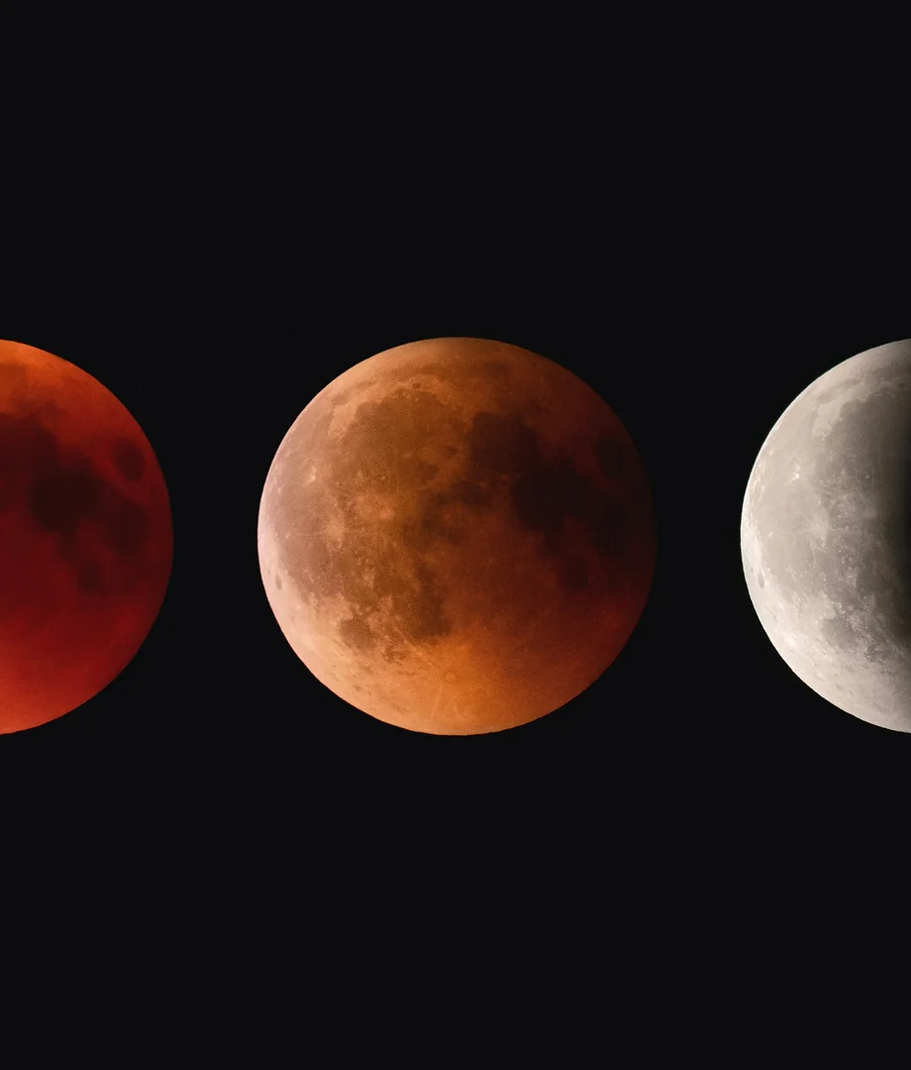
Dates and Calendar
Day-by-Day Guide to New Year
New Year's Eve
The first day
On the second day
The third and fourth days
On the 15th day

Slide 4

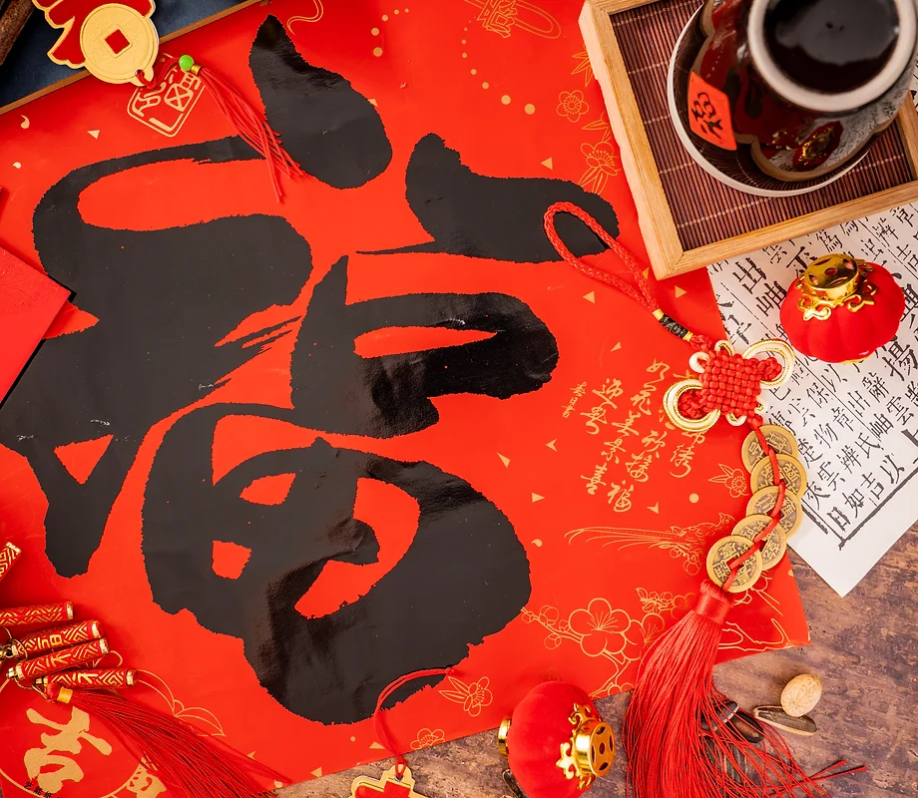
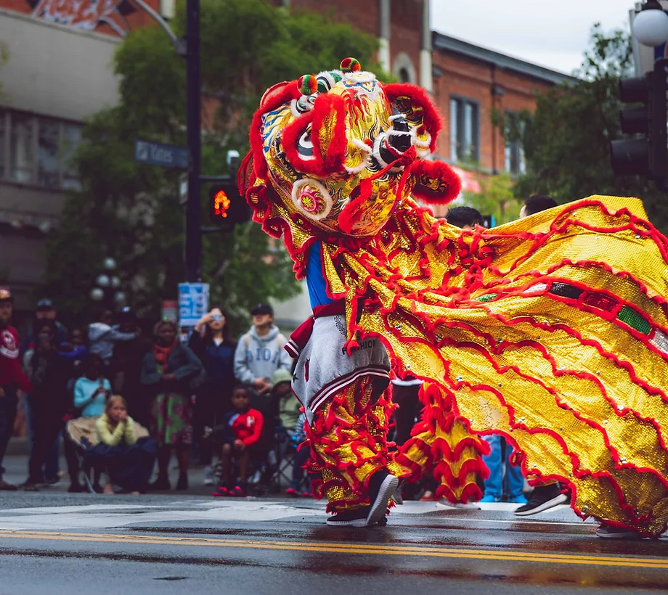
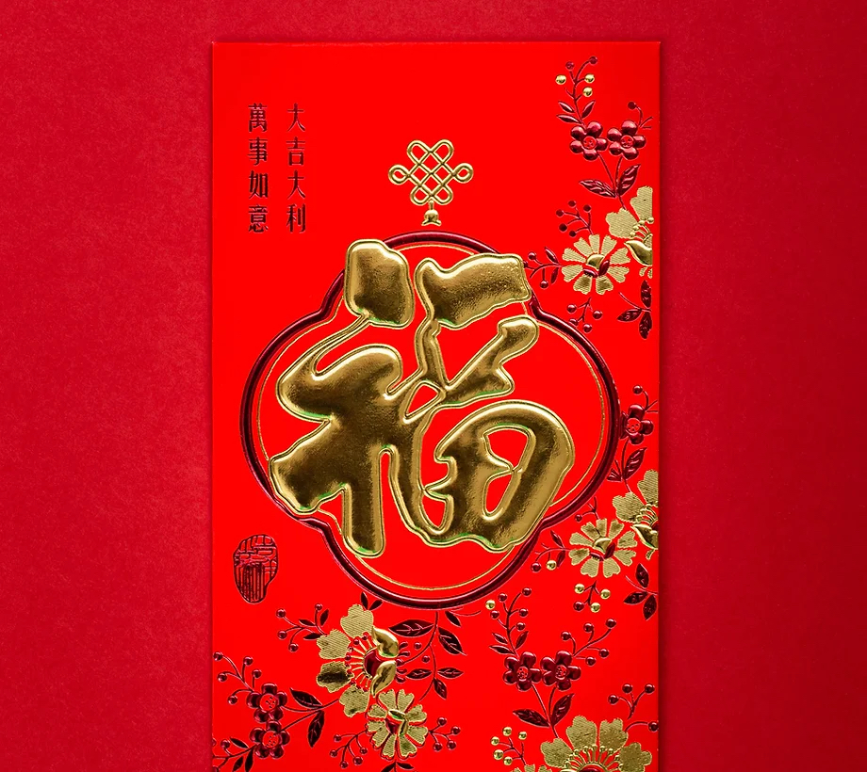
Chinese Customs
Dust Sweep
Paste the Chinese Character of Fu on the Door
New Year Lucky Money
Performing Lion-dance and Dragon-dance

Slide 5
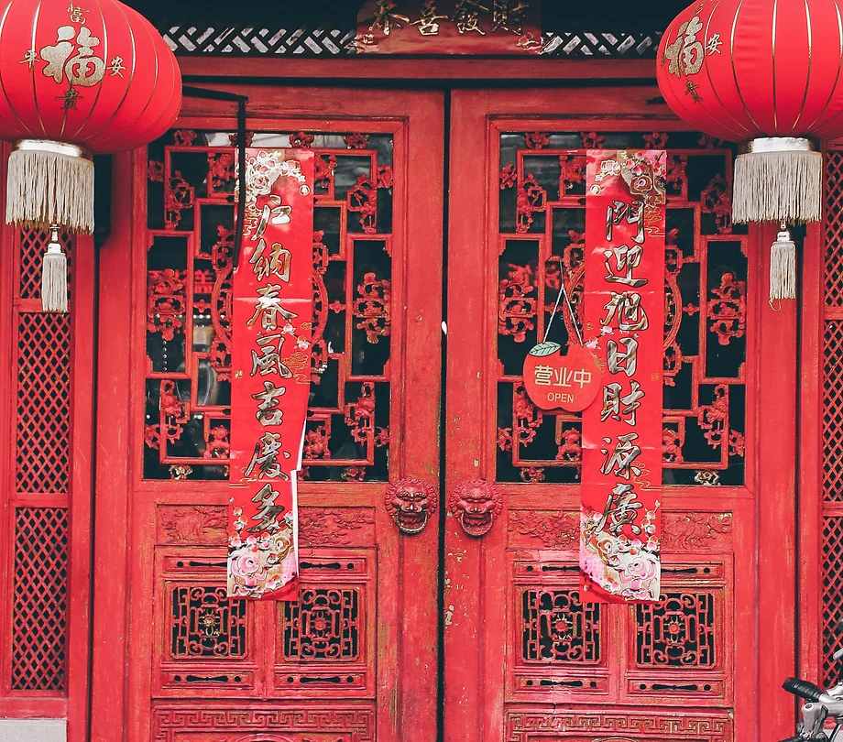
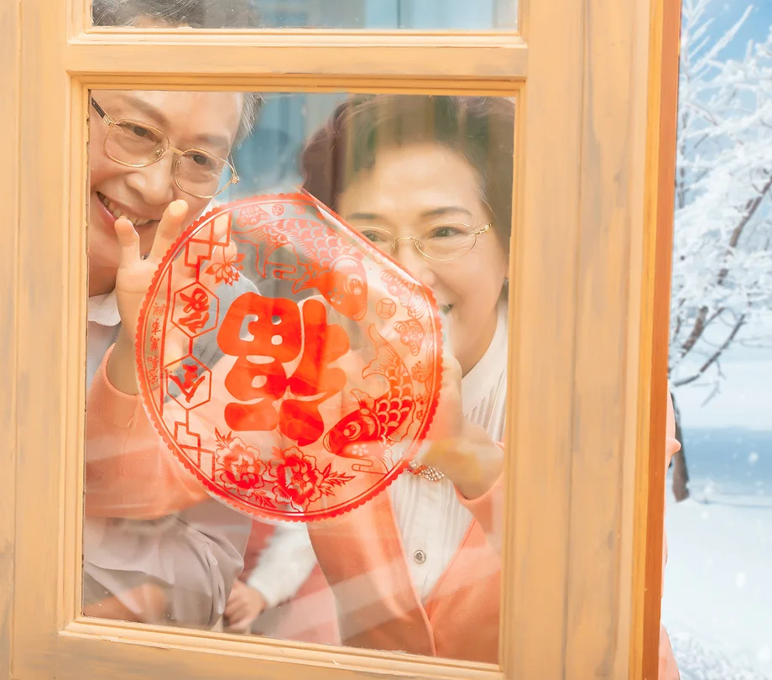
Chinese Customs
Paper-cuts for Window Decoration
Spring Festival Couplets and New Year’s Paintings

Slide 6
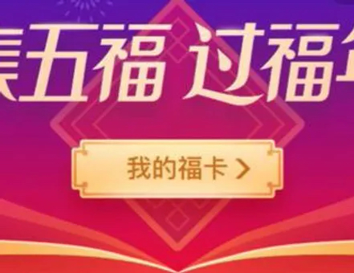
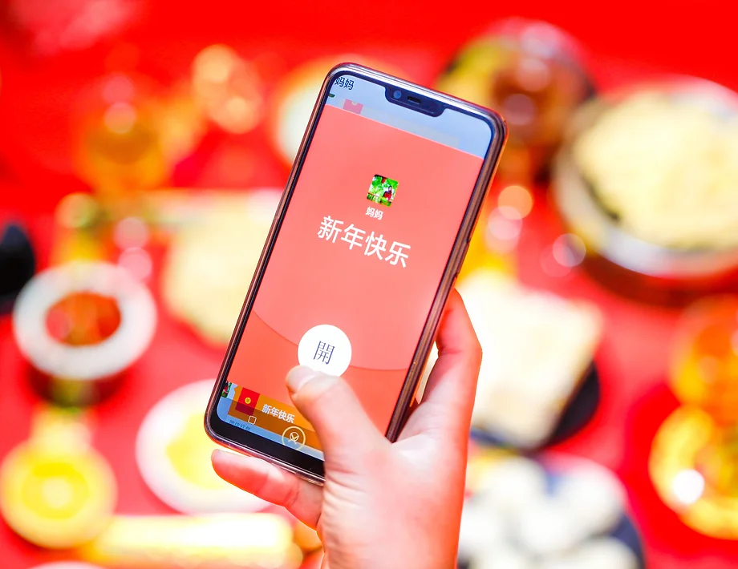
New Folk Customs
Grab digital red envelopes
Collect five ‘Fu’ cards

Slide 7
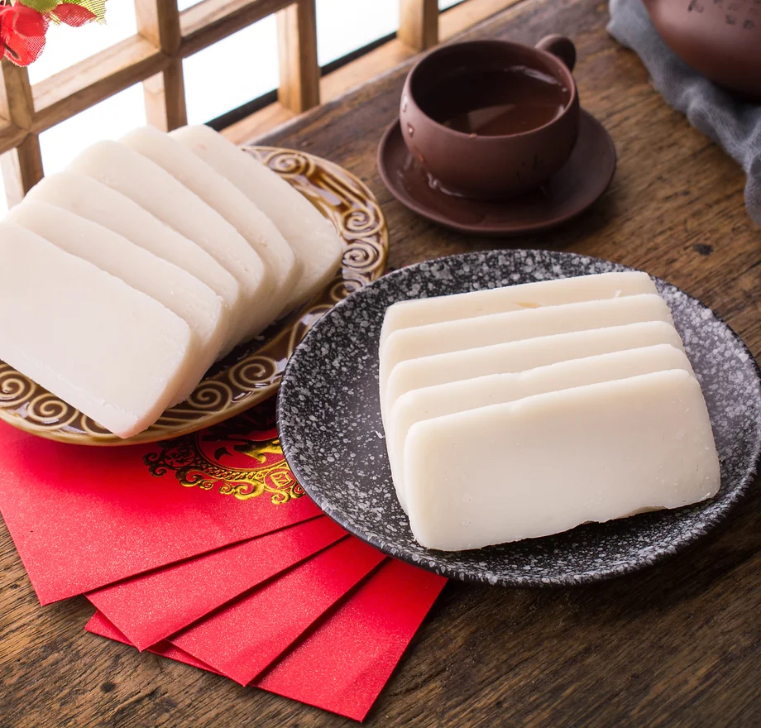
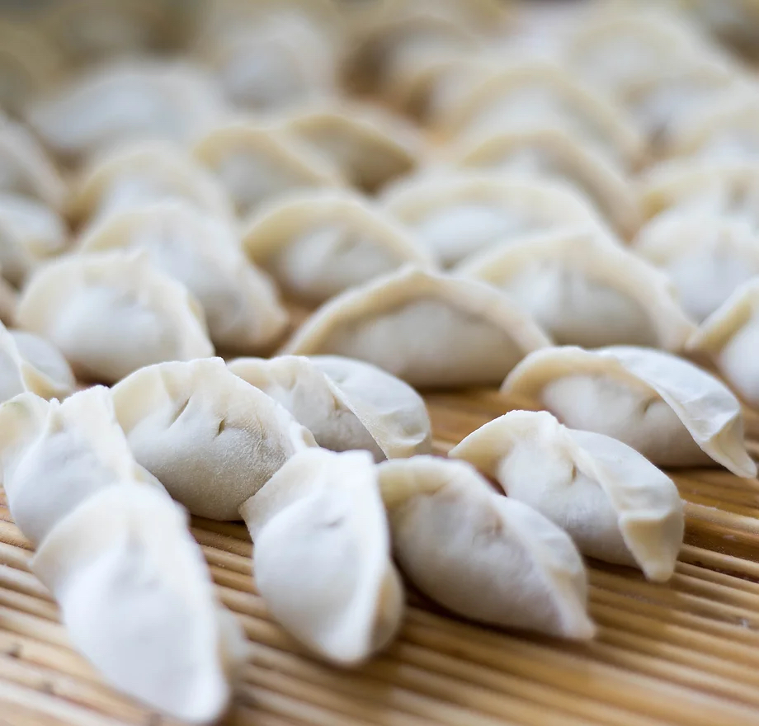
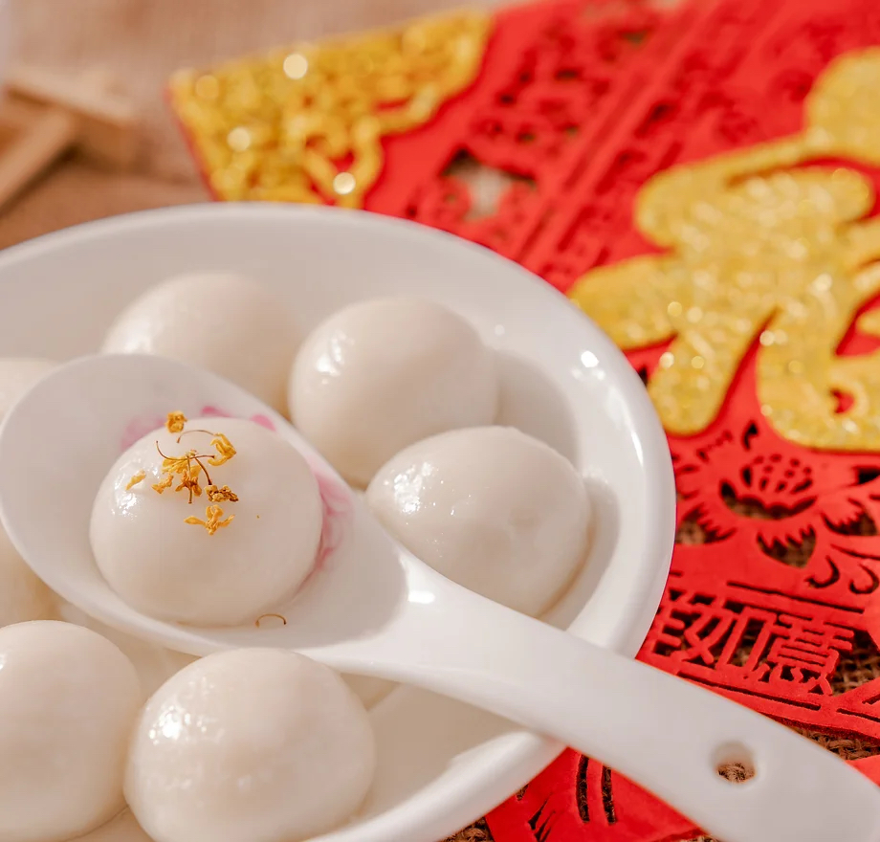
Chinese Spring Festival Food
Dumplings
Sweet Dumplings
Chinese New Year Cake

Slide 8
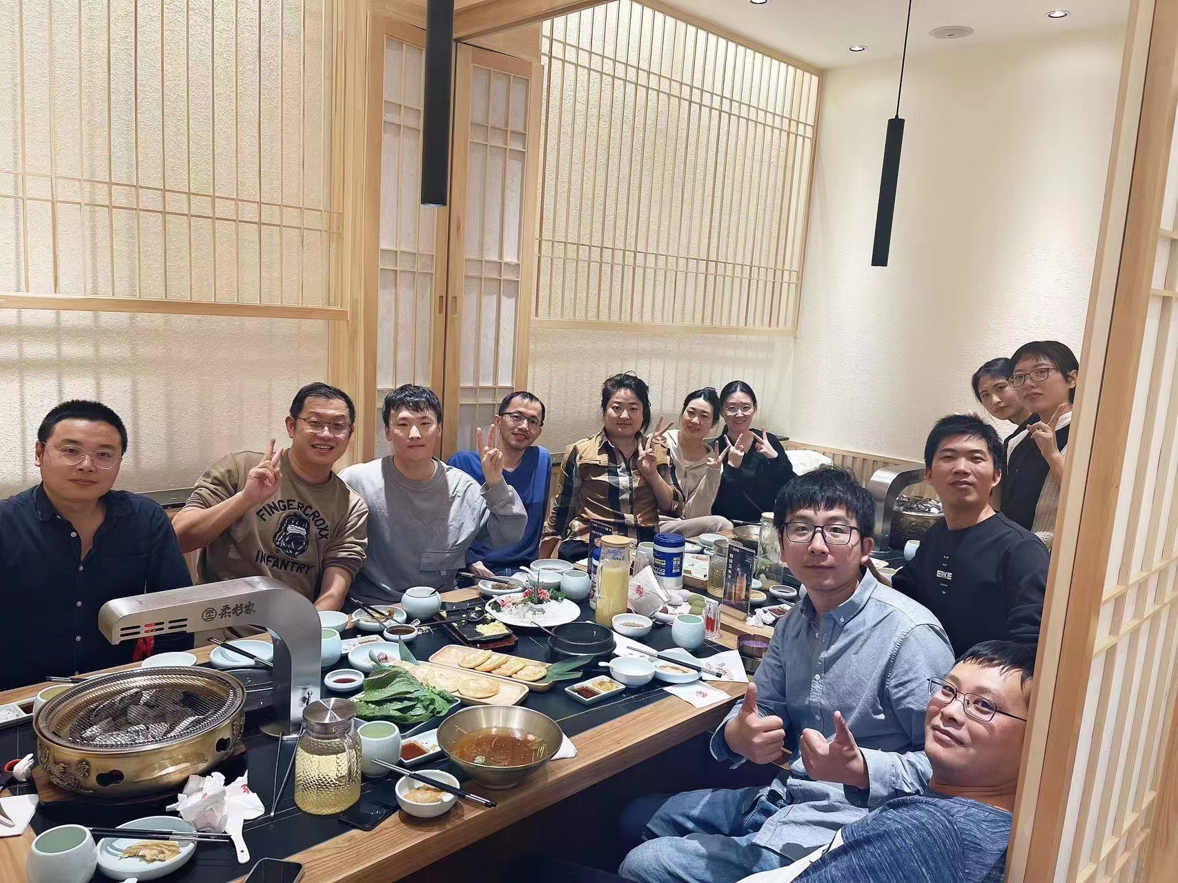
Chinese Customs
Reunion dinner

Slide 9
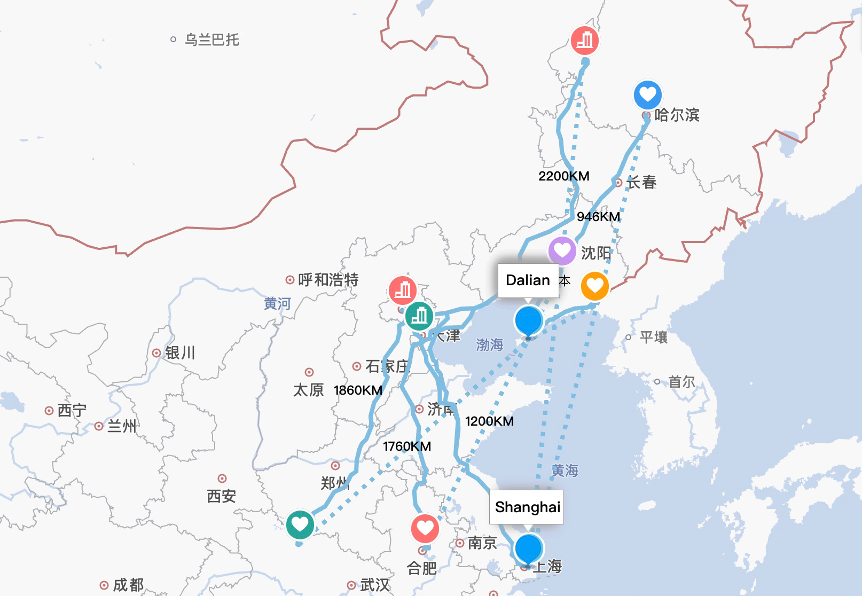
Spring Festival Travel Rush

Slide 10
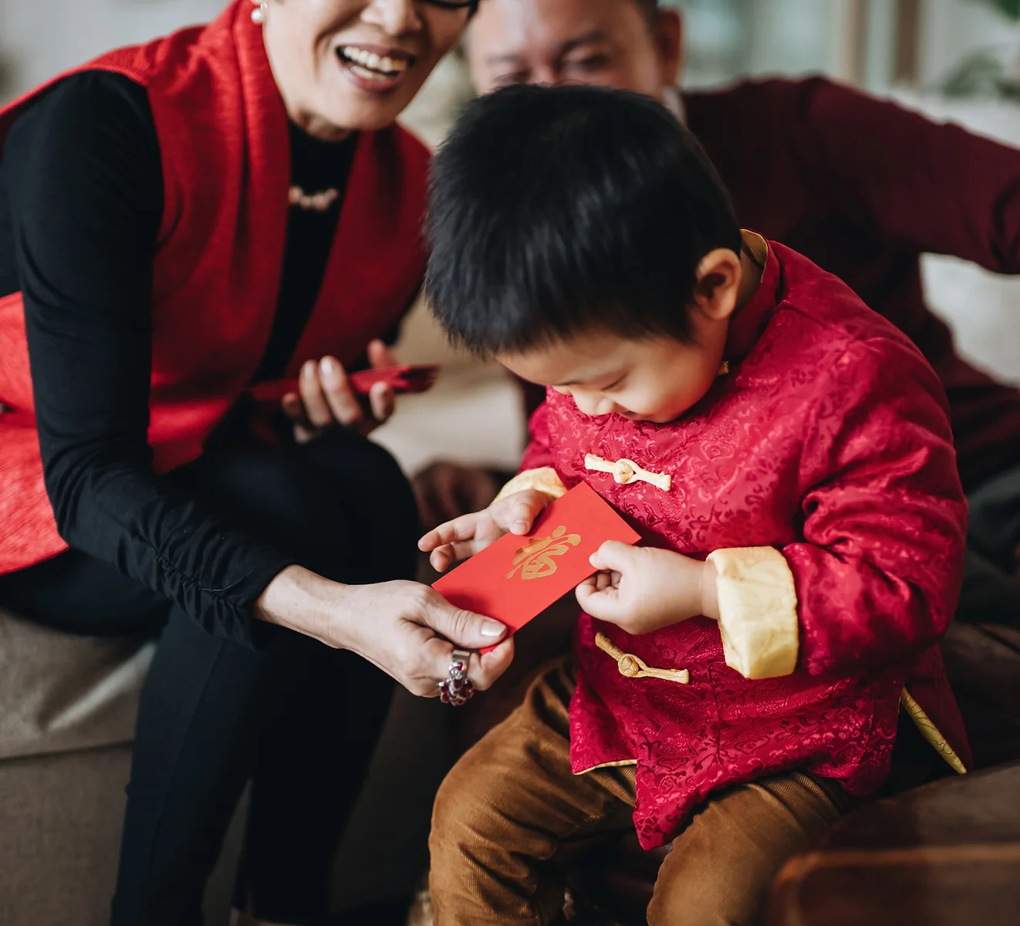
Chinese New Year Facts You Should Know
It is a festival for 1/4 of the world's population
The Chinese New Year date changes each year
Every Chinese New Year starts a new animal's zodiac year
It is the longest Chinese holiday
No haircuts for a month
The earliest firecrackers were made with bamboo

Slide 11
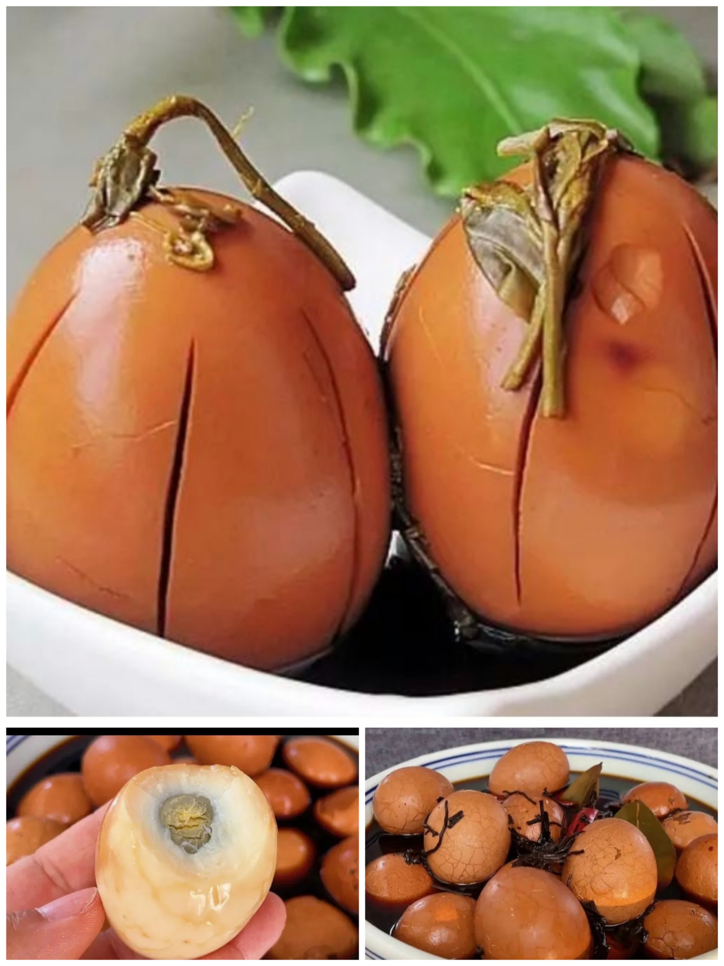
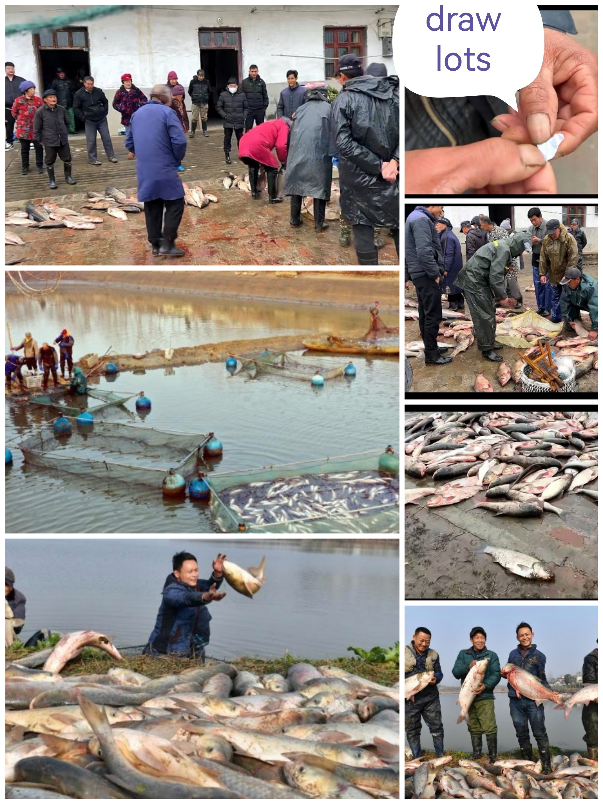

Slide 12
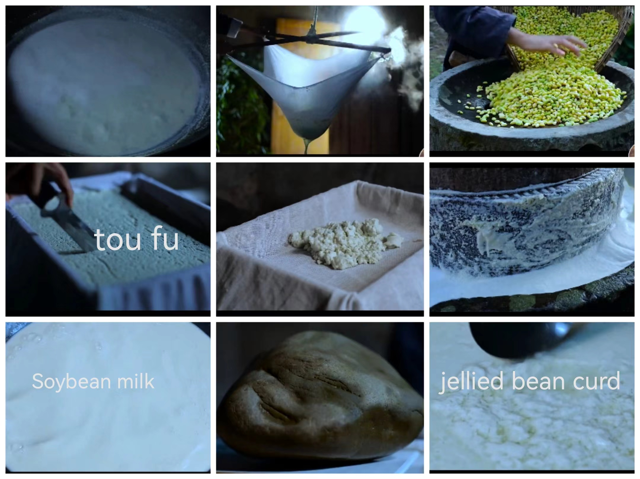

Slide 13
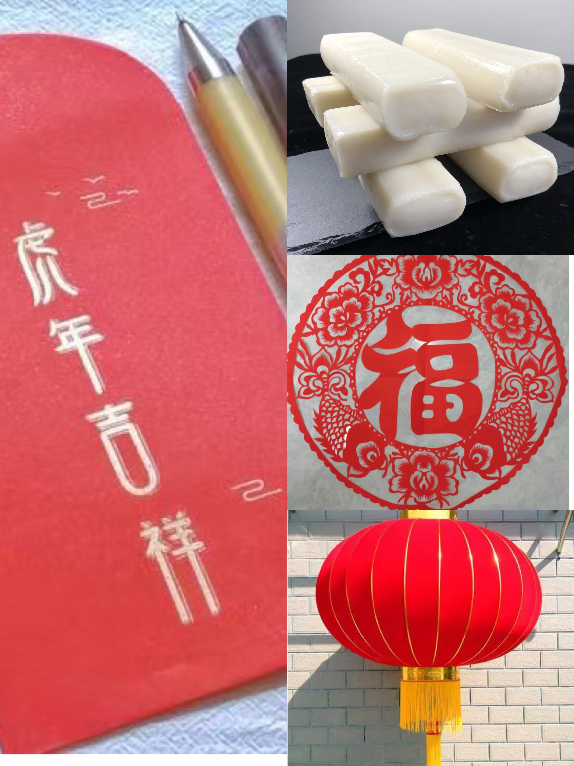

Slide 14
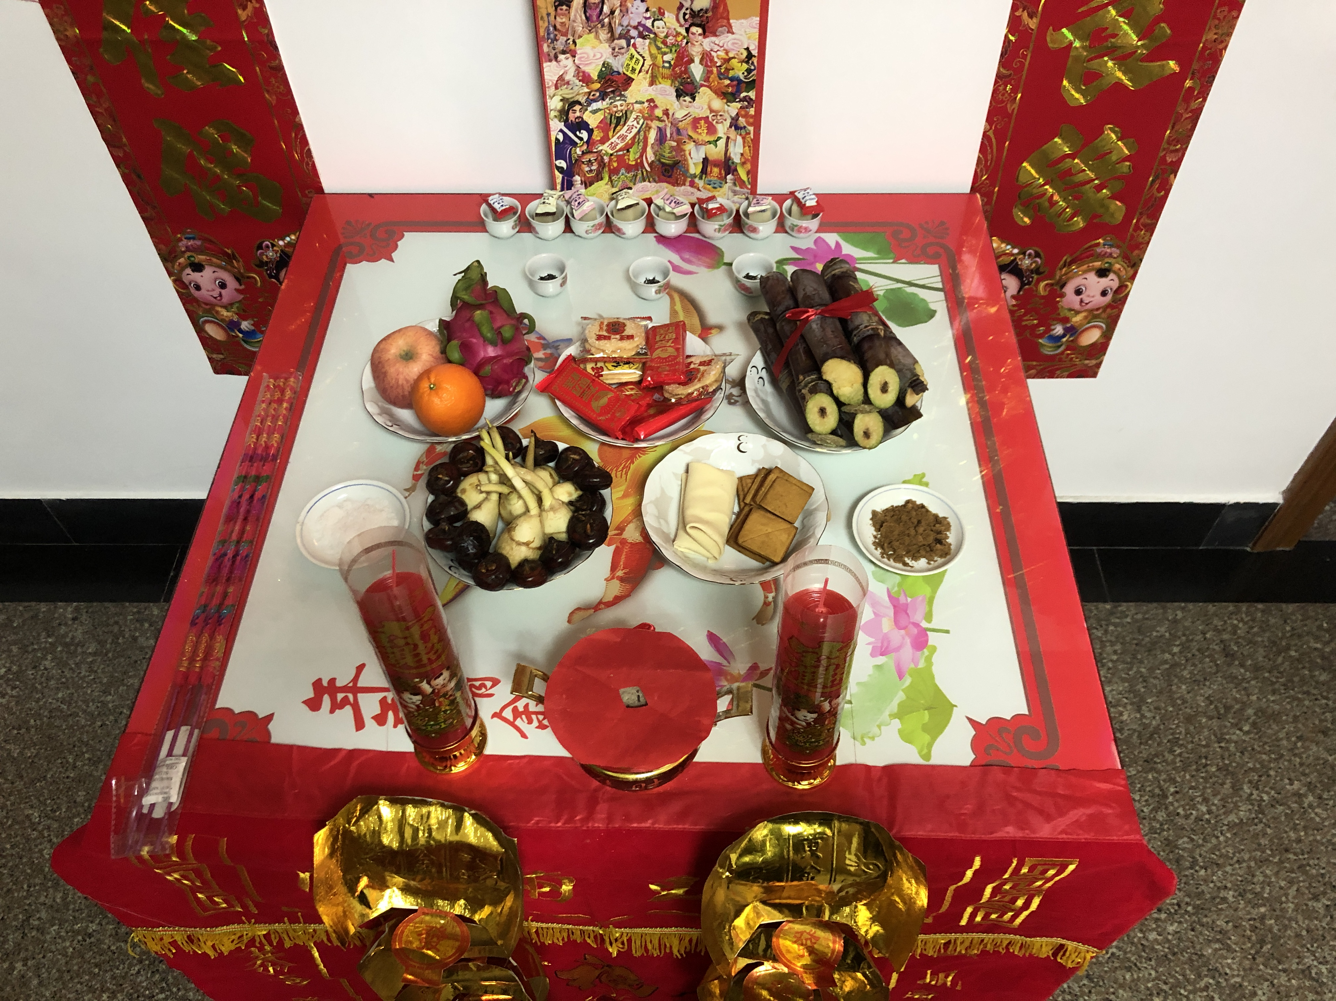

Slide 15
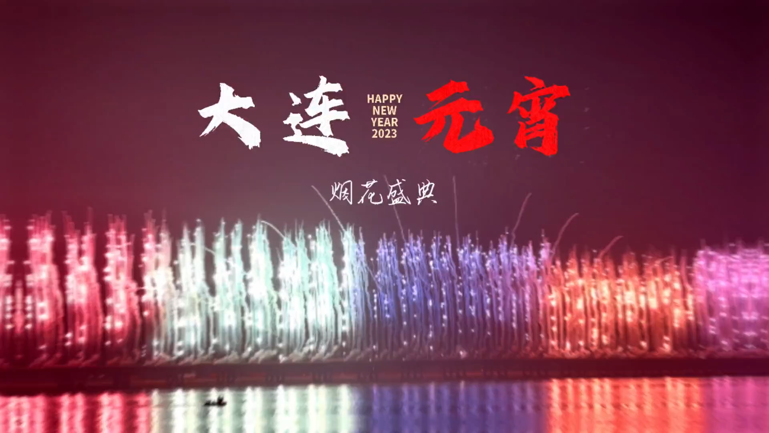
Fireworks and Greeting

